Slide 1

Recovering from Pandemic: An Opportunity to Redefine Education
Hybrid teaching combines the best of both worlds
Group 8: Noyonika Roy, Devon Lui, Urvaksh Irani, Tenzing Wangdu, Victoria Lilienthal, Ridwik Modi
Notes:
Good evening everyone, we are group 8 and are happy to present our work before you today. Our group consists of me Noyonika Roy, Devon Liu, Tenzing Wangdu, Victoria Lilienthal and Ridwik Modi. The topic that we have picked is relevant to each and everyone of us present here. Before we dive in, I would like to thank each classmate who answered our survey, it helped us get very valuable insights.
Now, as we all know, the pandemic wreaked havoc in our lives in 2020 and up-ended each aspect of it. For those of us in school, we felt a drastic change. We had to get accustomed to new ways of learning, interacting and taking exams. Now that we are at the end of the pandemic (hopefully) we are slowly transitioning back to normal i.e. pre-pandemic era. But in our opinion, we should not blindly revert to the way things were because the necessity of the pandemic has actually uncovered some revolutionary instructional modalities that be integrated with the old ones and could redefine education altogether. This is our opportunity, as we stand at the cusp of this transition to keep the best of both era and maximize the effectiveness of our courses through a hybrid delivery system.

Slide 2
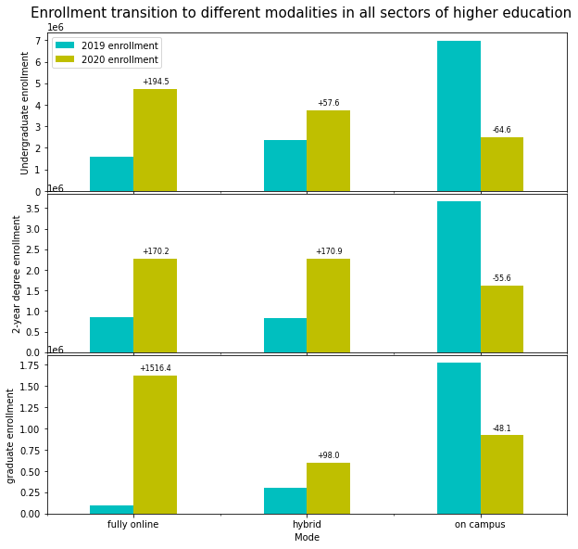
Modes of Education changed
Every mode of education was impacted
As schools went hybrid and online, most lives were disrupted
The percentage change in modes of education is shown here
Notes:
The concept of a hybrid and online education is not a new one but the popularity of these modes was low in pre-pandemic 2019. Maximum enrollment was seen in the on-campus modality. As we turn to 2020, with the pandemic thriving, we see a change in the enrollment of online classes across all higher education institutes in AsD, BaD and MaD. The change in graduate enrollment much higher than the decrease in on-campus enrollment providing support to our opinion that online modes must have some attractive qualities in them and would not be completely disregarded. The reason behind more graduate enrollment could be out of necessity like losing jobs or the result of an opportunistic thinking of learning new skills while working from home, in either case, a new mode of instruction arose.

Slide 3
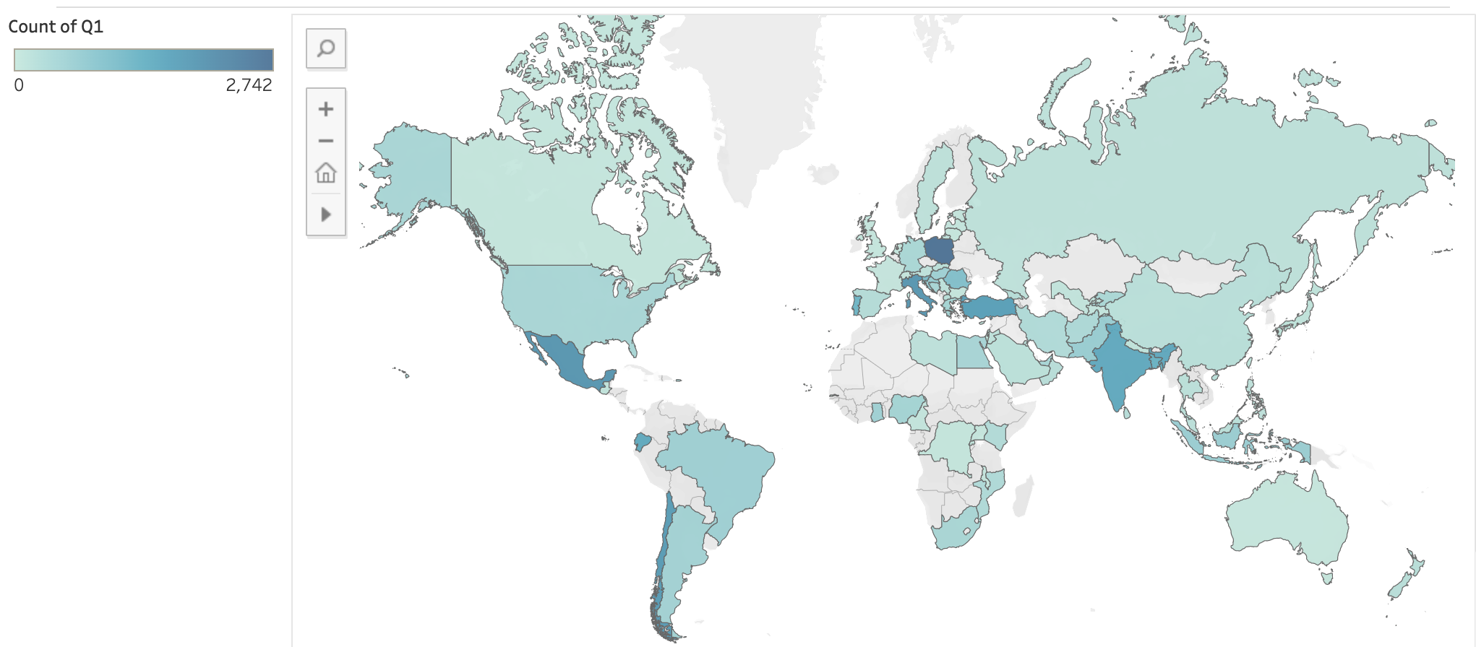
Our datasets covers the globe
Notes:
before we proceed, I would like to state here that the surveys that we used and the datasets that we used covered most countries and hence could be considered a global opinion.

Slide 4

Evaluation of online classes

Slide 5
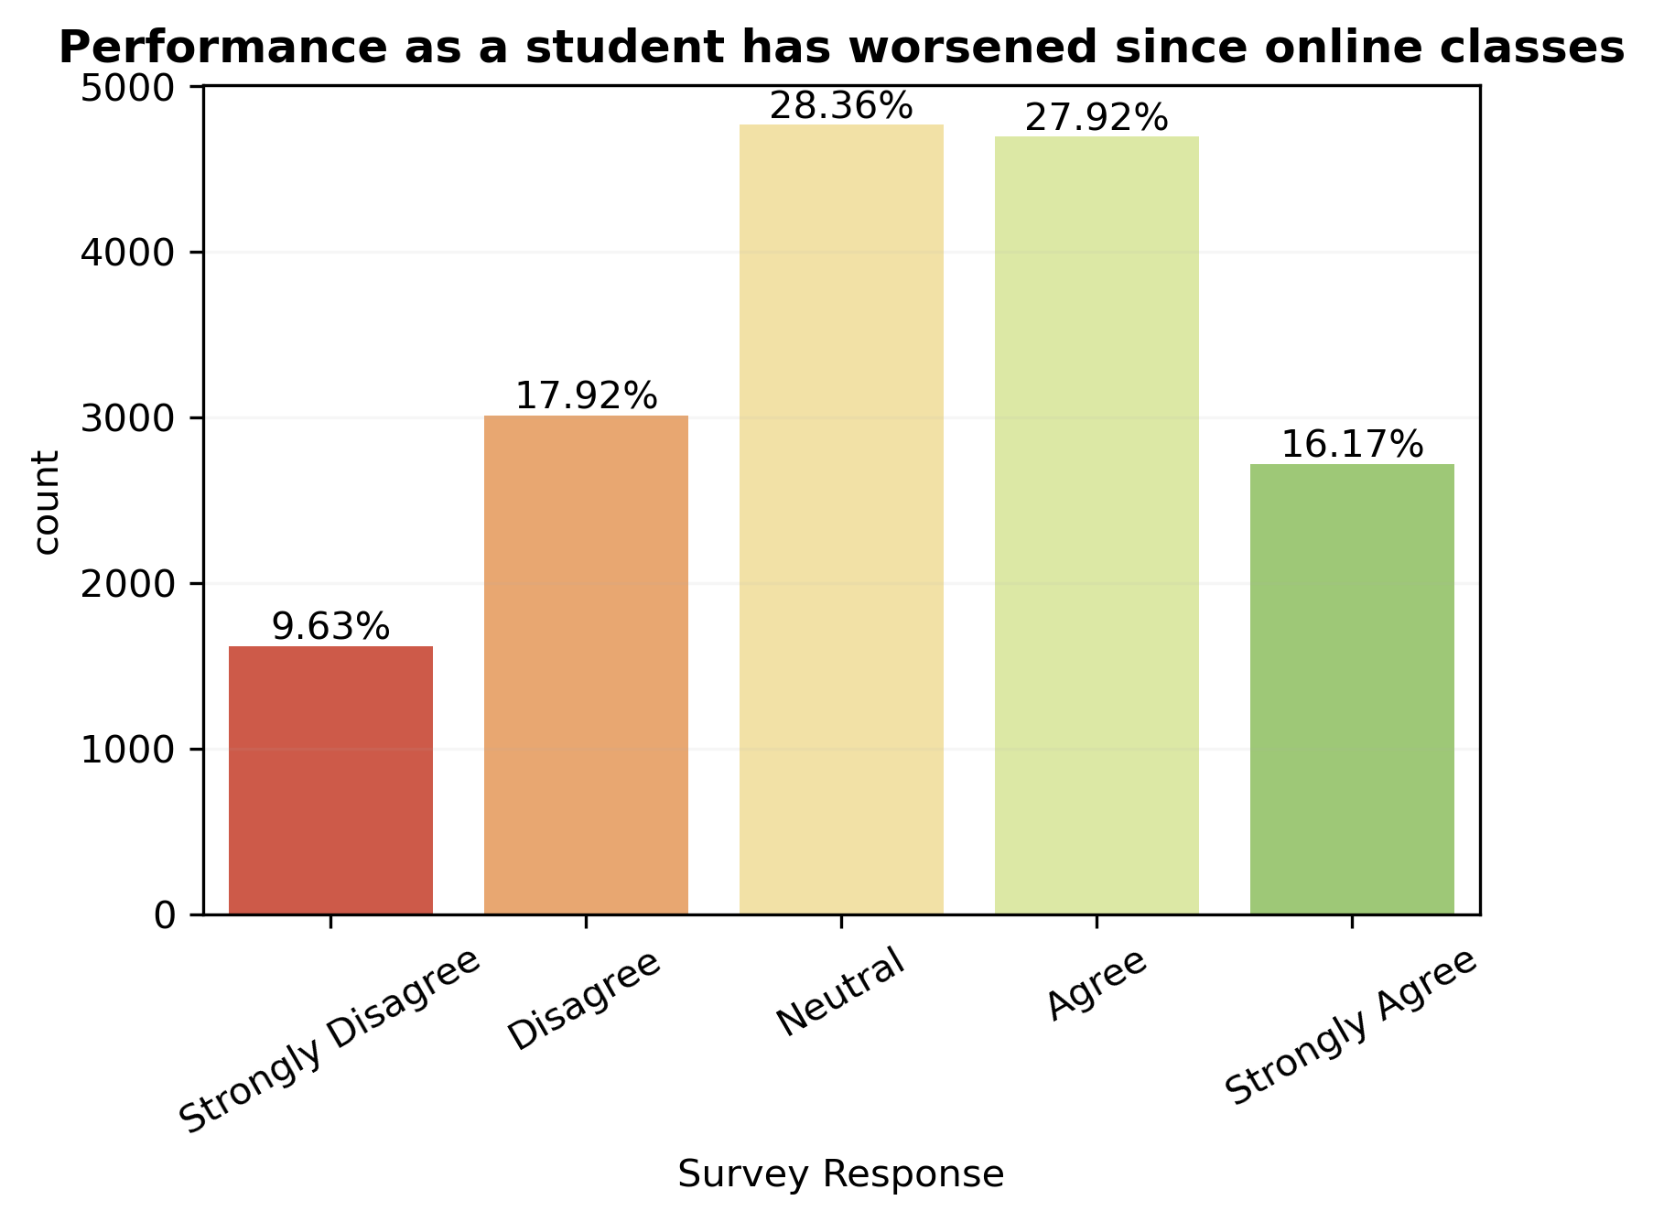
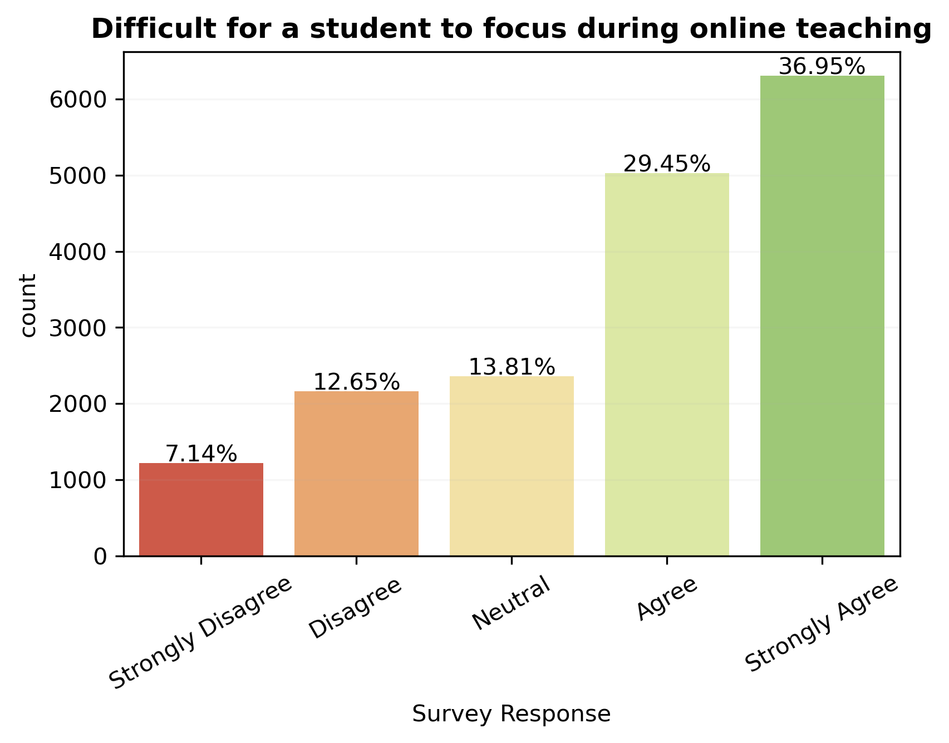
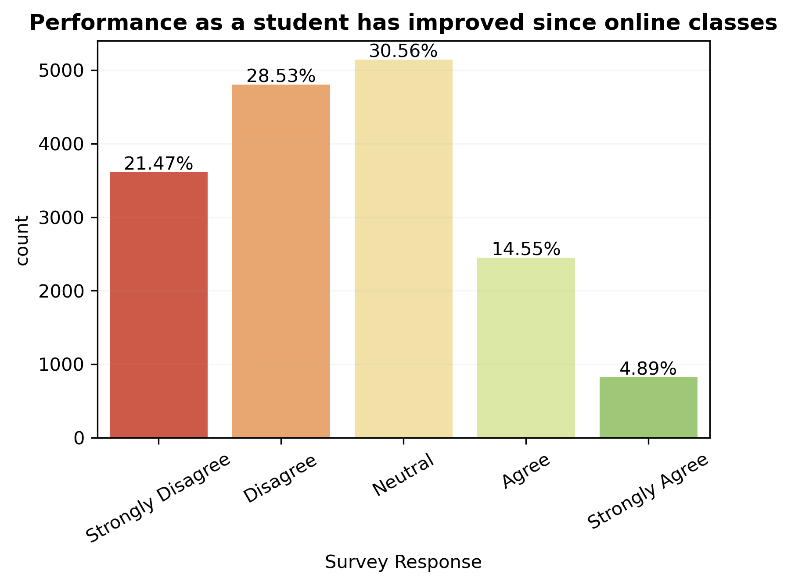
Lack of focus during online teaching has taken a toll on the morale and performance of a student

Slide 6
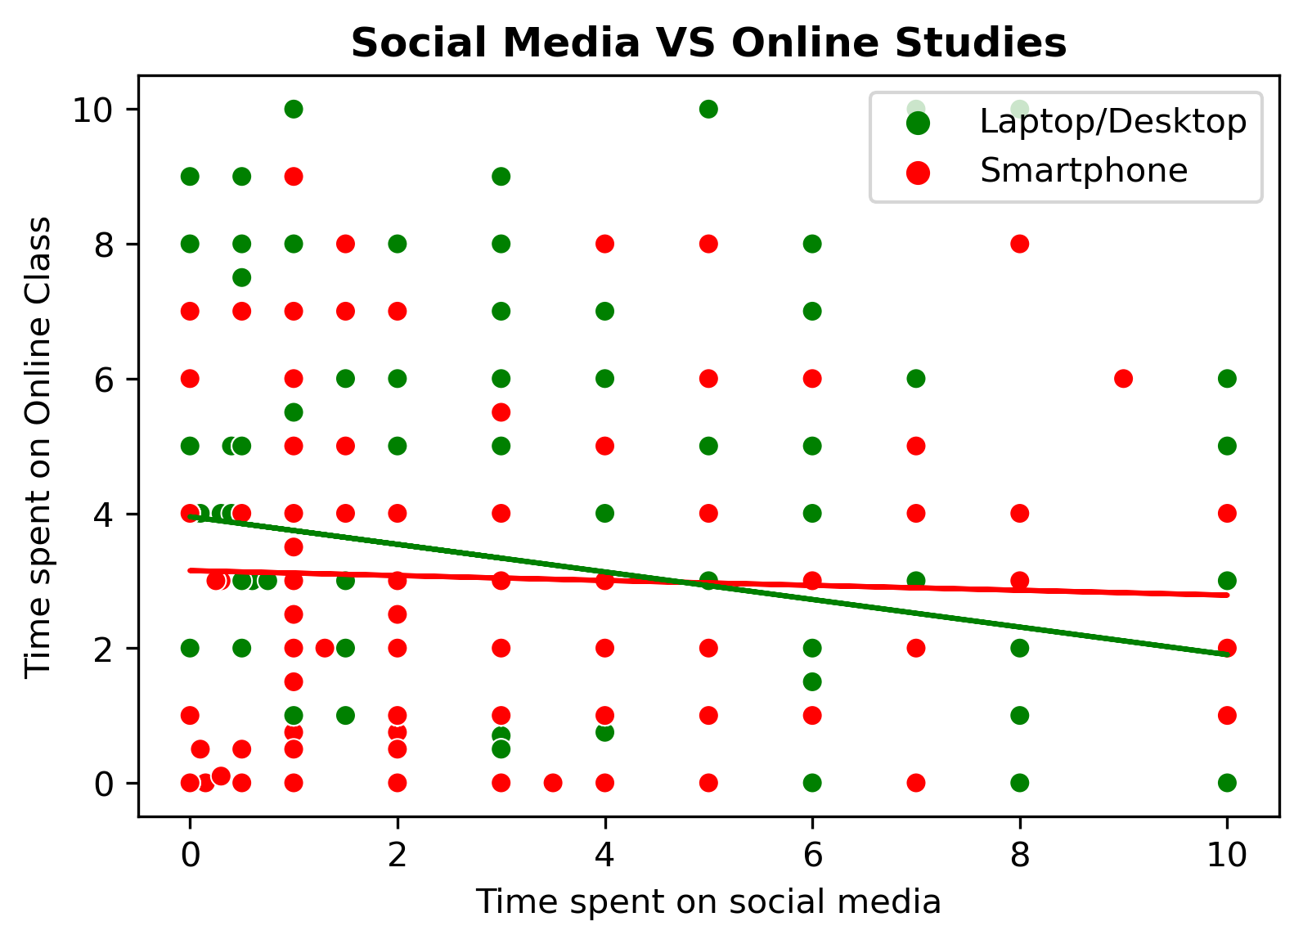
Relationship between Time spent on Online classes and Time spent on Social Media
On average students are spending more time on social media compared to online classes
The Laptop/Desktop (Green) line in the chart is slightly tilted which indicates that students using Laptops/Desktops tend to spend more time on Social media.

Slide 7
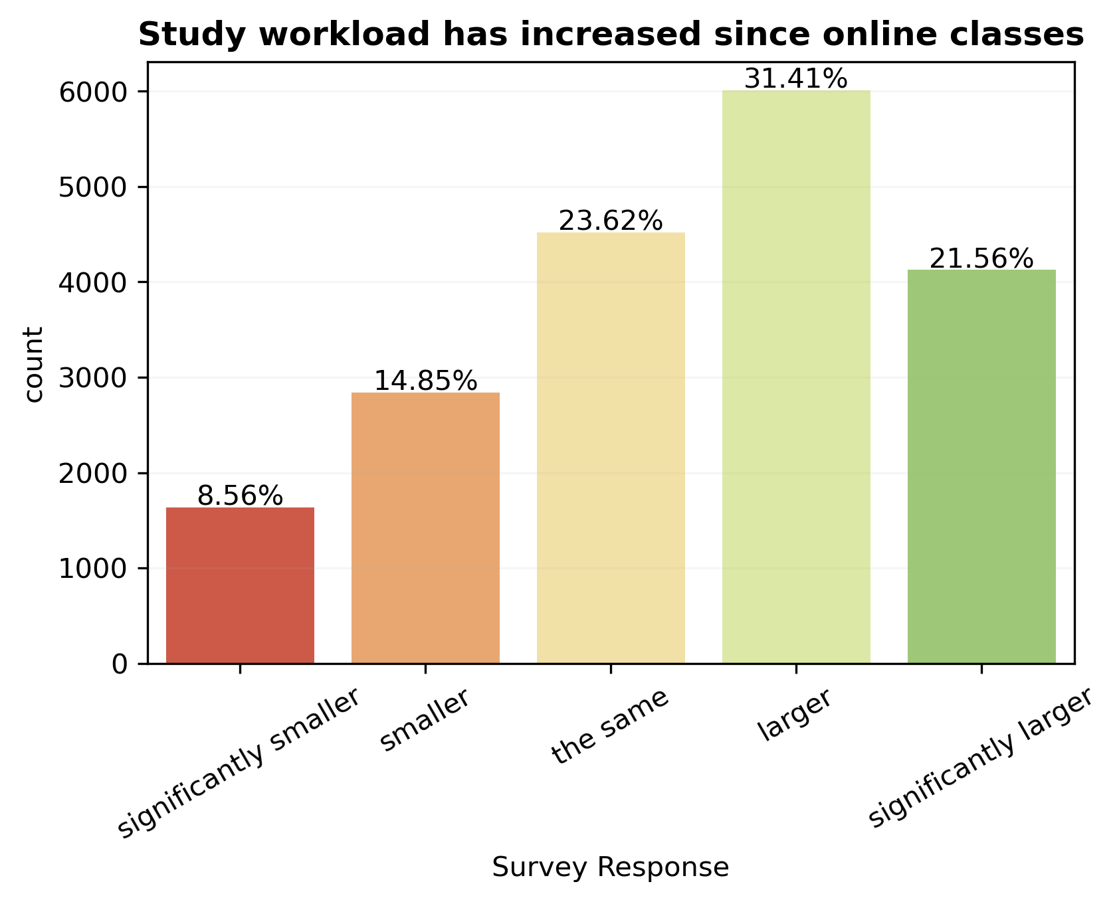
An increase in workload due to online classes has had a negative impact on students who are also working. They now have to prioritize between their job and education which could have an adverse effect on their performance at college.

Slide 8
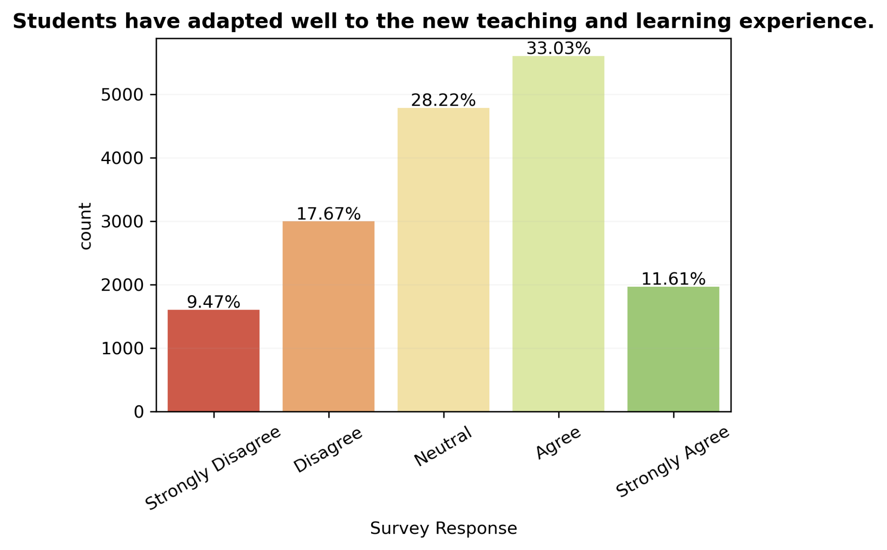
Reasons why students haven’t adapted well to the online teaching
Lack of resources to support online education
Inability to manage between job and education due to the sudden pressure from both areas
Communication gap between students and professors
Unsuitable Environment

Slide 9

Our Theory
Hybrid Classes
Online Exams
To incorporate the benefits of online learning without compromising on the effectiveness of offline teaching models it is best to adopt a hybrid model
Notes:
We asked our self what is the best conducive form of education- to maximize learning, networking and collaboration but reduce stress, anxiety and frustration for students. As we have experienced different teaching models due to the pandemic such as online, in person, and different hybrid models we were able to collect some information from our class through the survey and other datasets and test our theory. We believe a combination of hybrid classes and online exam might be the best solution.

Slide 10
Proposed education model
Requirements
In-person classes that are recorded for people who cannot attend
Online exams and assignments
Flexible office hours online and offline to give maximum support
Technology in class and technological training for students and professors
Newer exam formats and innovative assignments
Acceptance of change by faculty
Notes:
We propose in-person classes which are recorded so students who are not able to attend in person for whatever reason will not miss out on important information. This requires proper technology in class and might require training for professors and students. Exams and assignments can be taken online to reduce stress and anxiety so students can take the exam where it is most conducive for them. Professors and schools will have to develop new exam formats and create innovative assignments for a more flexible schedule. We also believe an option for online and offline office hours would be beneficial so students can receive maximum support. This would require more flexibility from professors.

Slide 11

Support for our theory
Change in commuting
Plenty Access to Technology
Effective
communication
Changed lifestyle habits
Better for mental health
Student preference
Notes:
We have tapped into a few topics to support our theory such as the benefits of mental health, the change in lifestyle habits and change in commute. We also looked at the preferences of students and how effectively they could communicate with their professors as well as the access to technology.

Slide 12
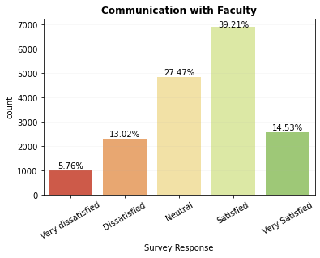
Communication with Faculty
Online interactions are satisfactory as students get one on one attention from the faculty
Students seem comfortable to reach out to their professors
Online communication is conducive to student and professor due to greater flexibility
Notes:
Online teaching has not had a drastically negative effect on communication for students with their professor however, some students might feel more comfortable talking in person to the professors as body language can make a difference in communication. One issue thats sometimes experience in online meetings is a lack of a stable internet connection making it sometimes difficult to stay in contact or defective devices such as broken camera or microphone.
However, students and professors can be more flexible with online meetings which leaves us to conclude that teachers should provide both options online and in person meetings.

Slide 13
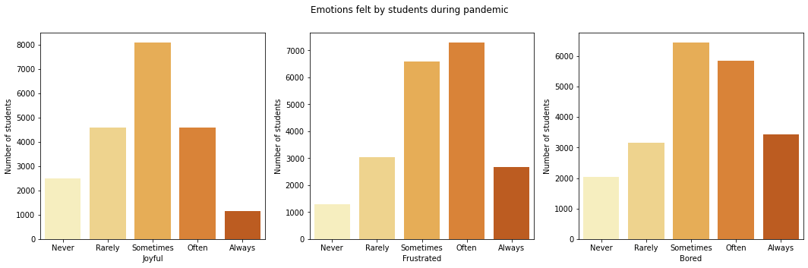
Mental health during the Pandemic
Notes:
Looking at the mental health responses of students having taken online classes it is noticeable that students have felt more often bored and frustrated. Likely due to the lack of socialisation and exercise. Another issue has been technical issues when taking online classes. Students still feel at times joyful but it is less pronounced than negative emotions which can cause mental instability and affect learning and motivative abilities or unusual sleeping patterns which devon will explain a little more in depth.

Slide 14
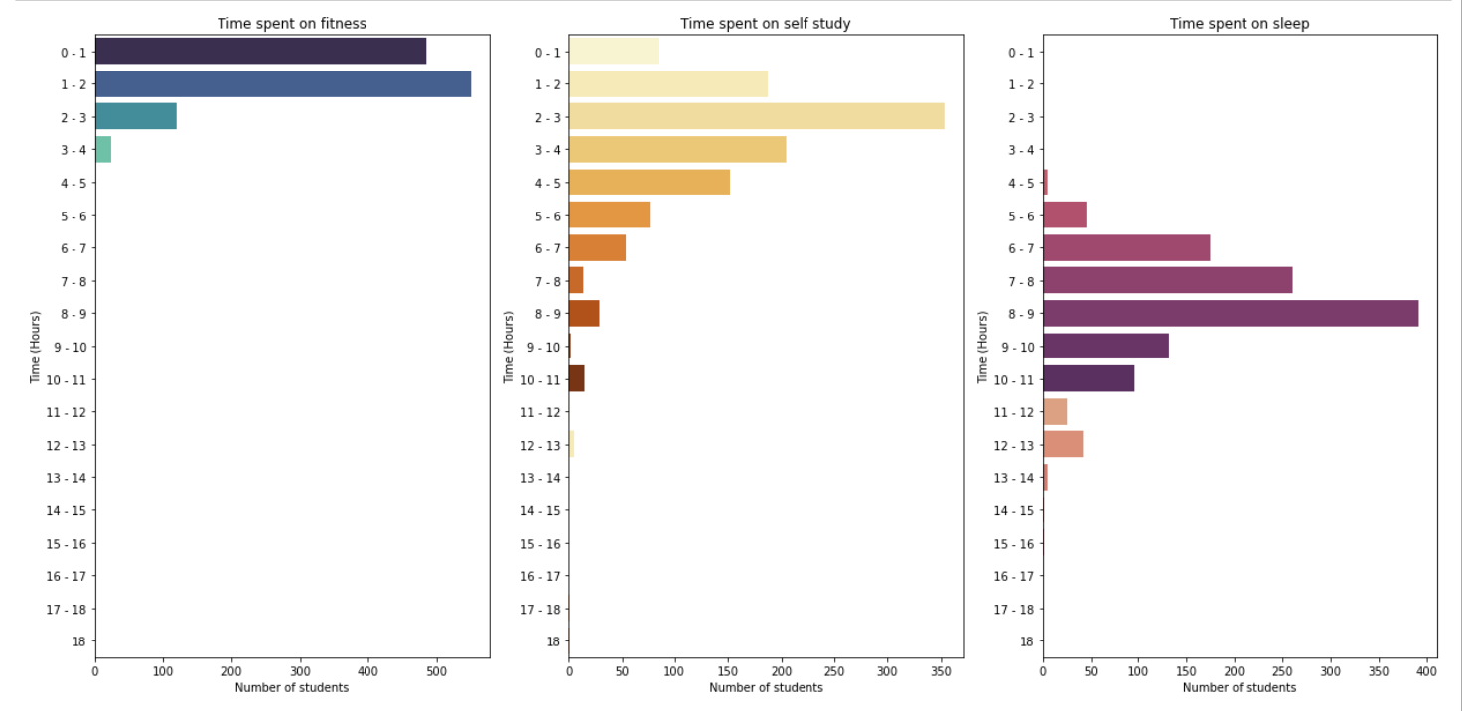
Habits During Pandemic
Notes:
As Noyonika mentioned, the pandemic has changed various habits of many students. Some notable habits are self-study, sleep, and fitness.
There is a interrelationship between sleep and exercise. Where more exercise improves sleep quality as one would be tired after working out. High quality and sufficient amount of sleep are associated with academic performance with increased concentration. When students’ attention span decreases, it results in lower academic achievement.
Now in this slide, I created 3 horizontal bar charts using a survey conducted by xxxx during the pandemic.
Starting with the 1st graph on the left, we have Time spent on fitness by students who took the survey. Clearly with the highest amount of votes, alittle over 540 students spent 1-2 hours total per day. For the 0-1 hour mark, we have 485 students who spent 0-1 hours a day. For the 2-3 hour mark, we have 120 students. And finally we have the 3-4 hour mark containing a significant spread in comparison with the other time intervals. From this graph, we can see that due to going in person, students trade in their fitness time for a hefty commute time.
Moving to the 2nd graph in the middle, we have Time spent on self study. In this chart, the hour interval with the greatest number of vote is 2-3 hours totaling 354 students allocating time to self study. For the 0-1 hour mark, there were 85 students. And in the middle of the spectrum at 10 -11 hour interval, there were only 15 students who had time to study for that many hours. Through this graph, one can derive that many are not able to allocate enough time to studying which may hinder performance in school.
Now for the last graph on the right, we have time spent on sleep. In the front we have a total of 392 students that are getting 8-9 hours of sleep. And the runnerup at 7-8 hour interval consists of 261 students. As seen through these numbers, one can conclude that students may prioritize their sleep which decreases time spent on other things like fitness and self study in a fully in person and virtual learning model. All in all, these habits all point to the ideal model being hybrid method and Ridwik will now dive deeper into this

Slide 15
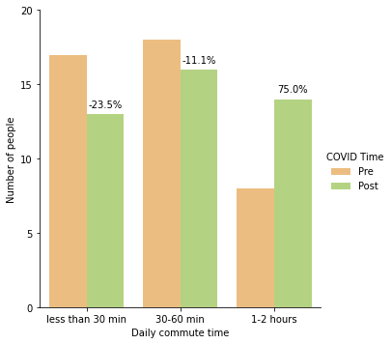
Students commute times
Students have moved further away
the overall commute time has increased
Notes:
A lot of people have lost their jobs in the pandemic. Making a living was not easy. Resources were short, people literally could not find toilet paper. Everything was overall expensive, which includes cos the living and real estate.
As we all know living in the city is not easy nor cheap. With everything moving virtual and more and more B2Cs coming in the market, we have everthning delivered at home. Why would people not want to move to a bigger place that would cost them even less. Which I think did actually happen. And to find out one of the questions from the survey answered that in our class to see the commute time difference. As you can see the daily commute has decreased by 23% for students with less than 30mins………………inc 75%.

Slide 16
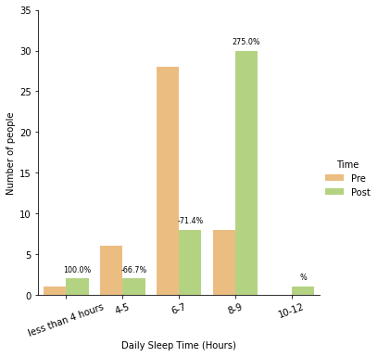
Change in Sleeping Pattern
Sleep cycle has been drastically affected in the pandemic.
There have been variations in people’s sleeping patterns
More hours are now allotted to keeping a healthy sleep cycle
Notes:
The pandemic has made people spend more time at home wanting them to sleep more I guess. It is good to sleep up to 7-8 hours. Not more nor less.
As you can see that the graph speaks for itself. After the pandemic the sleeping hours of students/people have gone up in total. People who sleep less than 4 hours have increased by 100%.......10-12 hours wow!
.

Slide 17
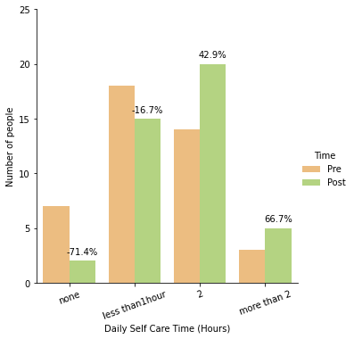
Change in Time alloted for Self Care
Increase in hours spent on healthcare.
People have become more health conscious and spend more time on their health.
Notes:
Countless lives were lost in the pandemic. I think this was a wake call for everyone to get more healthy and spend more time on themselves. A healthy life would definitely lead to a longer life.
As you can see the % change in people spending their time on self care and increased. It is great to see people spend so much time to get the best out of themselves.
I think consistency is the key, and the online exams would save time the commute time and would help students more time to invest in themselves so that they could calm down and fell better about themselves or invest that time on selfcare.

Slide 18
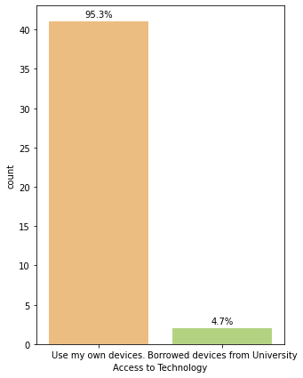
Access to Technology
Since majority of students have access to their own technology it would be great to have exams online.
Even the ones who don’t can access to technology can get it issued from the college library.
Notes:
Since majority of the students have access to technology they can work by themselves and give exams online.
The hybrid format should not be a problem. And for those who don’t have access to technology can forsure borrow it from the library.
The fact that they would not be dependent in any circumstances would be a great influence for a better output.

Slide 19
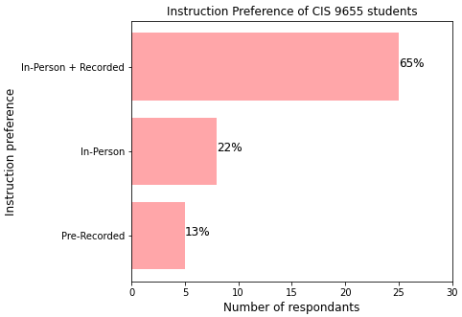
New formats of Class Instruction Now
65% of the response towards the online classes which were also recorded
Online learning offers flexibility
Notes:
Students could learn from anywhere and anytime. This also saves them the time it takes to commute to their classes.

Slide 20
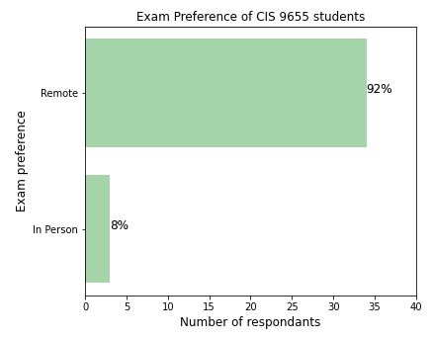
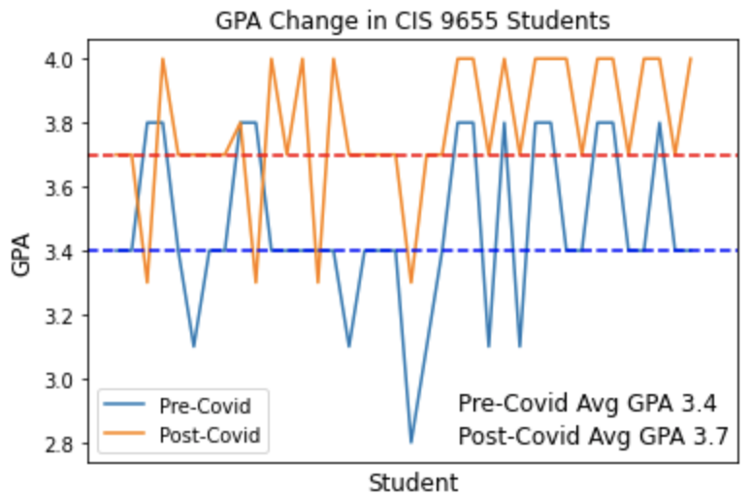
Understanding The Exam Preference of Students: In-Class Survey
Notes:
Furthermore, online exams also features an auto grading system and, since most online examinations use auto-grading, students are able to find out their score right after completing their test.
And now I will pass it on to Devon to conclude the presentation.

Slide 21
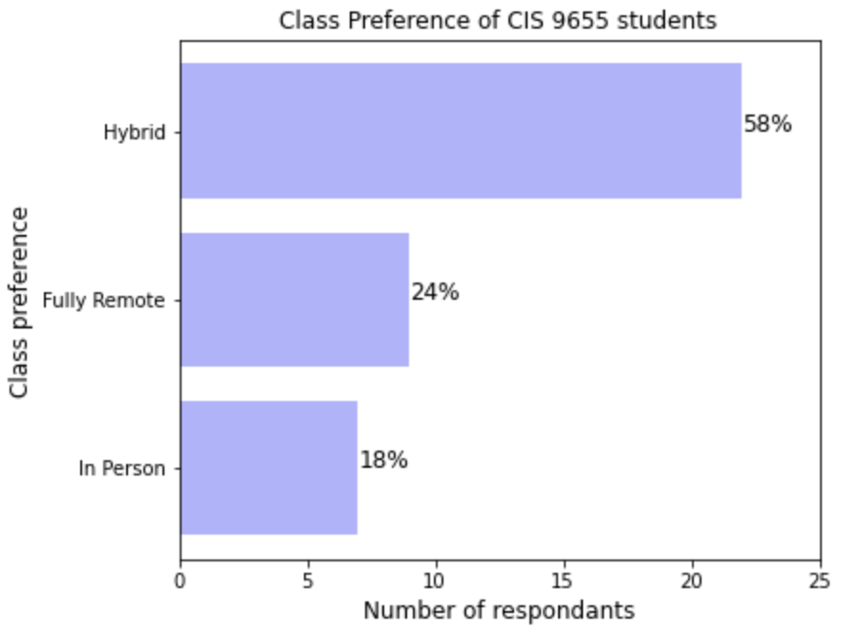
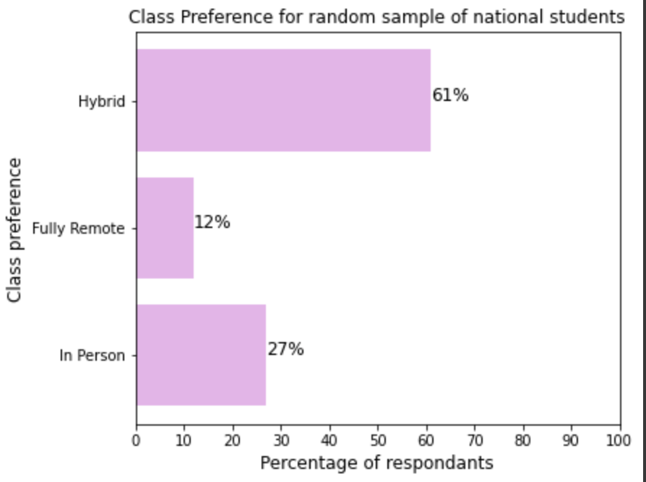
Conclusion
Hybrid classes are the most effective method of instruction and are preferred by students worldwide
Notes:
With the emergence of COVID-19, various aspects of life were impacted especially the lives of higher education students and learning models. Many professors have tried different models of learning such as fully in person, hybrid and fully remote environment. Each model has it’s advantages where fully in person allows for collaboration but wasted commute time. The fully online model provides more time for other habits but poses difficulty for students to maintain focus. The final and newer model that Group 8 supports the most was hybrid where exams and presentations should be virtual mixed with in person classes allowing higher academic achievement. Our group sent out a survey to get a pulse on what learning model students in this class prefers. And if we look at the first chart on the left, results came back with a majority in agreement with us where 58% of the class prefer hybrid, 24% students prefer fully remote and 18% prefer in person classes. Then our group also created another graph on the right which contains surveyed data of class preferences of national students. 61% of students want hybrid, 12% want fully remote and 27% want in person.
And finally To sum it up, based on the analysis performed, Group 8 deems that hybrid model is the winner and we urge more professors to implement this model.
Thank you!

Slide 22
Thank you

Slide 23
Data and code repository
Data Source: https://docs.google.com/spreadsheets/d/1fQD7oToA65oXNQN0_y5rbkAXTkUKHm0b/edit#gid=896115791
Code: https://colab.research.google.com/drive/18tprboq6gTyXFptsnsHNYVui67jOCgP_?usp=sharing
Our survey: https://baruch.az1.qualtrics.com/jfe/form/SV_8qW3KPLU83eNFTU
Worldwide survey: https://data.mendeley.com/datasets/88y3nffs82/5
Tableau map: https://public.tableau.com/shared/PFNWWXKTP?:display_count=n&:origin=viz_share_link

